Slide 1
Lecture# 07
Internet & Internet Technologies
SERVER CATEGORIES

Slide 2
Lecture contents
Server Implementation
Content Servers
Performance Servers
Database Servers
Mirrored Servers
Popular Server Products

Slide 3
Server categories
“Different servers do different jobs, from serving e-mail and video to protecting internal networks and hosting Web sites.”

Slide 4
Server Types
pedestal server
staging server
commerce server
server blade
secure serve
dedicated serve
virtual server
server mirroring
member server
server farm
application server

Slide 5
Server Types (Contd..)
Pedestal server: A type of computer rack. It is box-like frame or a columnar support for a server and may include wheels for easy transportation. (Exp. Fujitsu Primergy TX100 S3p, Dell PowerEdge T110 II)
Staging server: A server used as a temporary stage to test new or revised Web pages before they are made live.

Slide 6
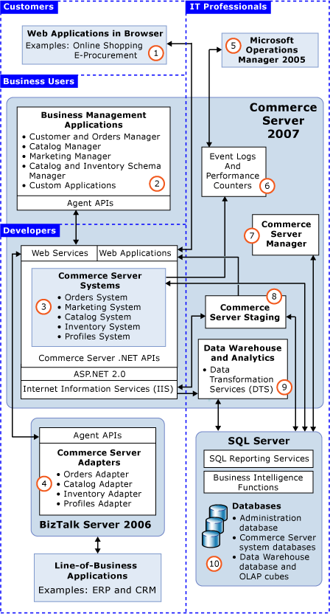
commerce server: Web software that runs some of the main functions of an online storefront such as product display, online ordering, and inventory management. The software works in conjunction with online payment systems to process payments. ( Microsoft Commerce Server 2002, Ascentium Commerce Server)

Slide 7
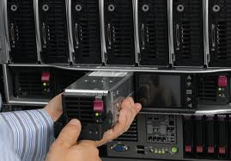
Server Types (Contd..)
server blade: A single circuit board populated with components such as processors, memory, and network connections that are usually found on multiple boards. Server blades are designed to slide into existing servers. Server blades are more cost-efficient, smaller and consume less power than traditional box-based servers. (Dell, Cisco)

Slide 8
Server Types (Contd..)
secure server: A Web server that supports any of the major security protocols, like SSL, that encrypt and decrypt messages to protect them against third party tampering. Making purchases from a secure Web server ensures that a user's payment or personal information can be translated into a secret code that's difficult to crack. Major security protocols include SSL, SHTTP, PCT (Private Communication Technology), and IPSec.

Slide 9
Server Types (Contd..)
dedicated server: A dedicated server is a single computer in a network reserved for serving the needs of the network. For example, some networks require that one computer be set aside to manage communications between all the other computers. A dedicated server could also be a computer that manages printer resources. Note, however, that not all servers are dedicated. In some networks, it is possible for a computer to act as a server and perform other functions as well.
In the Web hosting business, a dedicated server is typically a rented service. The user rents the server, software and an Internet connection from the Web host.

Slide 10
Server Types (Contd..)
virtual server: A server, usually a Web server, that shares computer resources with other virtual servers. In this context, the virtual part simply means that it is not a dedicated server -- that is, the entire computer is not dedicated to running the server software.
Virtual Web servers are a very popular way of providing low-cost web hosting services. Instead of requiring a separate computer for each server, dozens of virtual servers can co-reside on the same computer. In most cases, performance is not affected and each web site behaves as if it is being served by a dedicated server. However, if too many virtual servers reside on the same computer, or if one virtual server starts hogging resources, Web pages will be delivered more slowly.

Slide 11
server mirroring
Utilizing a backup server that duplicates all the processes and transactions of the primary server. If, for any reason, the primary server fails, the backup server can immediately take its place without any down -time.
Server mirroring is an expensive but effective strategy for achieving fault tolerance. It's expensive because each server must be mirrored by an identical server whose only purpose is to be there in the event of a failure. A less expensive technique that is becoming more and more popular is clustering.

Slide 12
member server
As defined by Microsoft, in Active Directory server roles, computers that function as servers within a domain can have one of two roles: member server or domain controller. A member server is a computer that runs an operating system in the Windows 2000 Server family or the Windows Server 2003 family, belongs to a domain, and is not a domain controller. Member servers typically function as the following types of servers: file servers, application servers, database servers, Web servers, certificate servers, firewalls and remote-access servers.

Slide 13
server farm
Also referred to as server cluster, computer farm or ranch. A server farm is a group of networked servers that are housed in one location. A server farm streamlines internal processes by distributing the workload between the individual components of the farm and expedites computing processes by harnessing the power of multiple servers. The farms rely on load-balancing software that accomplishes such tasks as tracking demand for processing power from different machines, prioritizing the tasks and scheduling and rescheduling them depending on priority and demand that users put on the network. When one server in the farm fails, another can step in as a backup.
Combining servers and processing power into a single entity has been relatively common for many years in research and academic institutions. Today, more and more companies are utilizing server farms as a way of handling the enormous amount of computerization of tasks and services that they require.
A Web server farm, or Web farm, refers to either a Web site that runs off of more than one server or an ISP that provides Web hosting services using multiple servers.

Slide 14
application server
Also called an appserver, and application server is a program that handles all application operations between users and an organization's backend business applications or databases.
An application server is typically used for complex transaction-based applications. To support high-end needs, an application server has to have built-in redundancy, monitor for high-availability, high-performance distributed application services and support for complex database access.

Slide 15
Mostly used Server
Proxy Servers: Proxy servers sit between a client program (typically a Web browser) and an external server (typically another server on the Web) to filter requests, improve performance, and share connections.
Mail Server: Almost as ubiquitous and crucial as Web servers, mail servers move and store mail over corporate networks (via LANs and WANs) and across the Internet.

Slide 16
Mostly used Server (Contd..)
Server Platforms: A term often used synonymously with operating system, a platform is the underlying hardware or software for a system and is thus the engine that drives the server.
Web Servers: At its core, a Web server serves static content to a Web browser by loading a file from a disk and serving it across the network to a user's Web browser. This entire exchange is mediated by the browser and server talking to each other using HTTP.
Application Servers: Sometimes referred to as a type of middleware, application servers occupy a large chunk of computing territory between database servers and the end user, and they often connect the two.

Slide 17
Mostly used Server (Contd..)
Real-Time Communication Servers: Real-time communication servers, formerly known as chat servers or IRC (Internet Relay Chat) Servers, and still sometimes referred to as instant messaging (IM) servers, enable large numbers users to exchange information near instantaneously.
FTP Servers : One of the oldest of the Internet services, File Transfer Protocol makes it possible to move one or more files securely between computers while providing file security and organization as well as transfer control.

Slide 18
Mostly used Server (Contd..)
Collaboration Servers: In many ways, collaboration software, once called 'groupware,' demonstrates the original power of the Web. Collaboration software designed to enable users to collaborate, regardless of location, via the Internet or a corporate intranet and to work together in a virtual atmosphere.
List Servers: List servers offer a way to better manage mailing lists, whether they be interactive discussions open to the public or one-way lists that deliver announcements, newsletters or advertising.
Telnet Servers: A Telnet server enables users to log on to a host computer and perform tasks as if they're working on the remote computer itself.
Open Source Servers: From your underlying open source server operating system to the server software that help you get your job done, open source software is a critical part of many IT infrastructures.
Virtual Servers: In 2009, the number of virtual servers deployed exceeded the number of physical servers. Today, server virtualization has become near ubiquitous in the data center. From hypervisors to hybrid clouds, ServerWatch looks at the latest virtualization technology trends.

Slide 19
Popular Server Products
Intel® Servers and Server Products
Sun Servers
Servers and Server products from HP
Linux server product
Microsoft Server Products

Slide 20
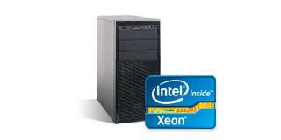
Intel® Servers and Server Products
Intel® Xeon® Processor E7-8800/4800/2800 Product Families
These top-of-the-line processors deliver performance that is ideal for your most data-demanding workloads with improved scalability, and increased memory and I/O capacity, allowing you to handily adapt to changes in short-term business demands, and address requirements for longer-term business growth. Advanced reliability and security features work to maintain data integrity, accelerate encrypted transactions, and maximize the availability of mission-critical applications. The powerful and reliable Intel Xeon processor E7-8800/4800/2800 product families – flexibility for your business-critical solutions.

Slide 21
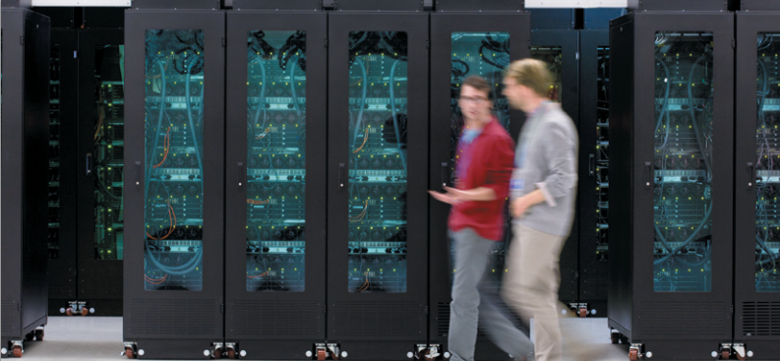
Actual Views of server

Slide 22
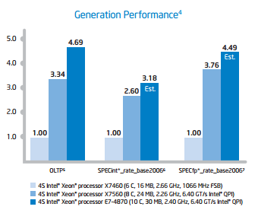

Slide 23
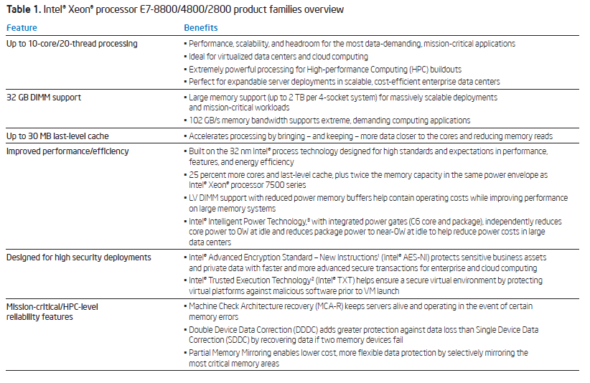

Slide 24
Sun Servers
Oracle's servers are engineered to deliver record-breaking performance, simplified management, high availability, and cost-saving efficiencies.
These industry-leading systems include built-in virtualization, cloud management and systems management, and are optimized to run Oracle Solaris, Oracle Linux, Oracle VM, and Oracle Enterprise Manager Ops Center.
In addition, these servers support industry leading software for Oracle and non-Oracle applications and solutions.

Slide 25
SPARC Servers
SPARC SuperCluster
Sun x86 Systems
Sun Blade Servers
Sun Netra Carrier-Grade Servers

Slide 26
Linux Servers
Reliability, Availability and Serviceability
Advanced Security
Cross-Platform Virtualization
Simplified Administration, Development and Systems Management
Interoperability with Other platforms
High Performance Computing
Modular Extensions for Advanced Capabilities
World-Class Support

Slide 27
SUSE
REDHAT
UBUNTU
DEBIAN
SOLARIS

Slide 28
Microsoft Server
Products
Windows Server 2012
Windows Server 2008 R2
Microsoft SQL Server 2008 R2
Windows Server 2003 R2
Windows HPC Server 2008
Microsoft Hyper-V Server
Windows Small Business Server 2008
Windows Home Server
Windows Small Business Server 2011 Standard
Windows Small Business Server 2011 Essentials

Slide 29
Assignment
Give a clear comparison of various server products available in the markets with respect to cost and stability for small, medium and large organization.
Submission date: 01/07/2019

Slide 30
Next Class ☺
Using the World Wide Web: Evolution of the World Wide Web,
Web Browser Software,
Using Browsers to Access Web Pages,
Customizing your Browser,
Images & Web Browsers,
Wireless Web Protocols

